Slide 1
Addressing the Claim that Independent Practice Will Solve the Rural Access Issue in South Carolina
Hint – It Will Not
(the Devil is in the Details)
Dr. Jeff Cashman

Slide 2
If We Are Solving for Increased Access to Primary Care in Rural Areas….
Data Show that only a fraction of NPs provide primary care
If they were going to help rural primary care, NPs could have done so under existing law
NPs and Physicians practice in the same areas of the state
Granting independent practice in other states has not solved the issue
Granting independent practice will not solve the issue in SC Either
There are better solutions

Slide 3
1. Data show that only a fraction of NPs provide primary care

Slide 4
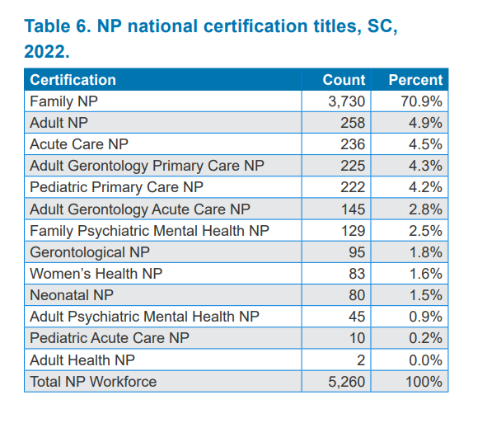
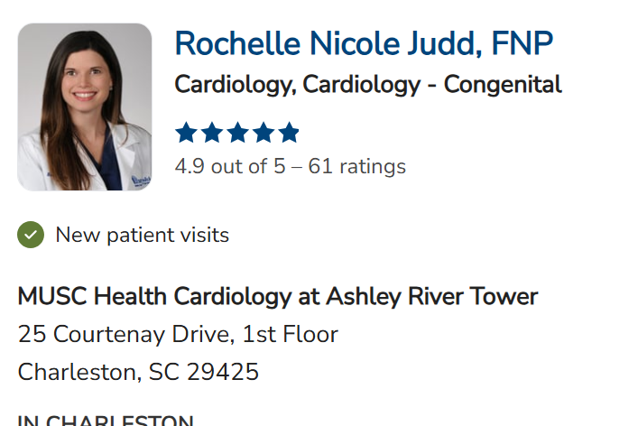
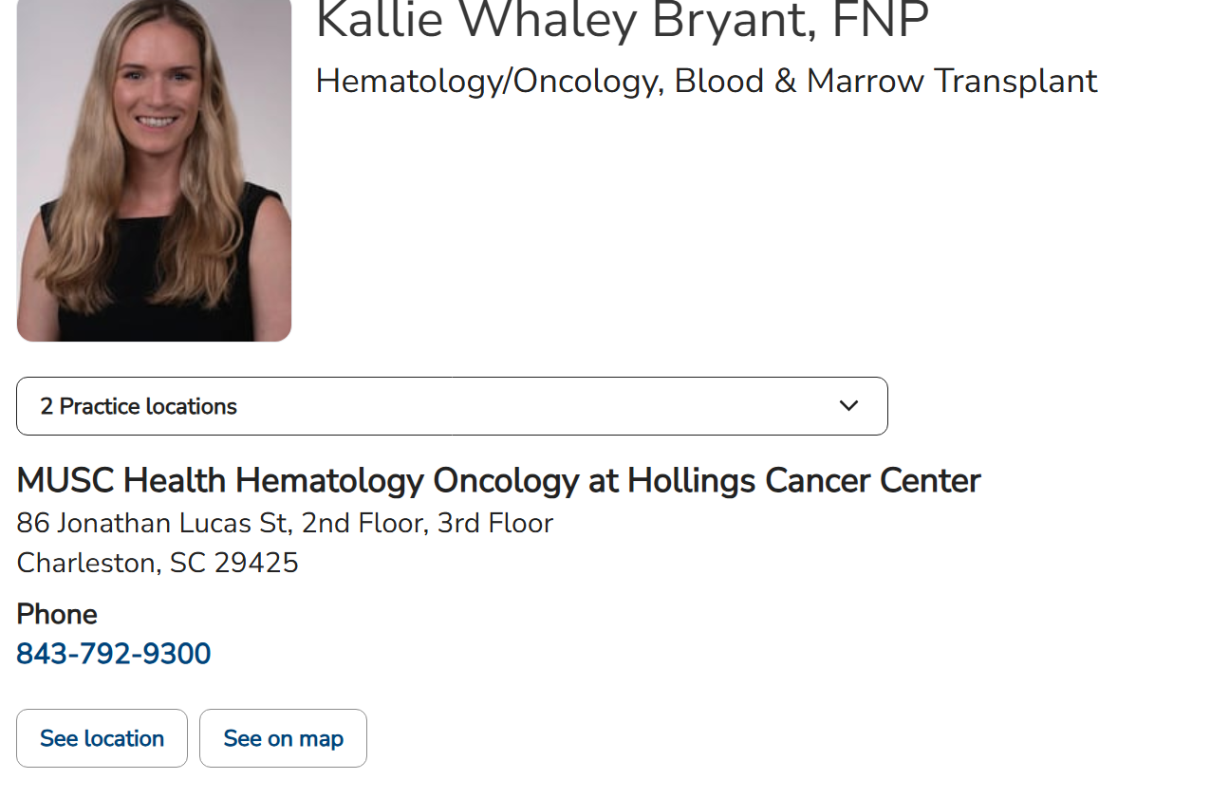
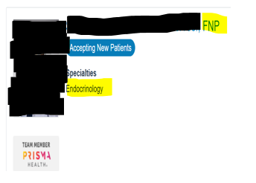


















Family Nurse Practitioners (FNP) Practice Primary and Other Specialty Care
Family NP = A Certification Type, Not Practice Area – NPs are not tracked in AHEC data by practice specialty
Many FNPs are Practicing in
Specialty Areas, Not Primary Care, across SC, but Counted in the FNP Category
Other Examples of Many in SC –
From One System’s Website –
  25 Cardiology FNPs
  14 Ortho Surgery FNPs
  27 Oncology FNPs
From Another System’s Website –
  9 Cardiology FNPs
  22 Oncology FNPs
  8 Neurology FNPs
  5 Gastroenterology FNPs
*Taken from system websites of only a few locations and few specialties
The NPs claim that the AHEC data show that 70% of NPs are doing primary care, and 83% in rural and underserved areas.
To quote “The NPs are the ones maintaining primary care in this state. Not the physicians, it is the nurse practitioners.” The data show otherwise.

Slide 5
Data Show Many FNPs Are Choosing Specialty Care
Milbank Memorial Fund’s 2024 Primary Care Scorecard Report
  While 90% of NPs are certified to work in primary care, only about 1/3 choose that field of practice (No One Can See You Now - Study on Primary Care)
Further evidence that the NP’s claim that 70% of them are practicing primary care in SC is false
Year | NPs | Primary Care NP | Percentage in Primary Care
2016 | 147,697 | 46,905 | 31.8
2017 | 164,497 | 51,687 | 31.4
2018 | 185,425 | 57,432 | 31.0
2019 | 208,847 | 63,920 | 30.6
2020 | 235,491 | 72,329 | 30.7
2021 | 259,456 | 88,211 | 34.0

Slide 6
HRSA Projections Confirm that Many FNPs do not practice in Primary Care
The Health Resources and Services Administration (HRSA) 2022 National Sample Survey of Registered Nurses (NSSRN) suggest the number of NPs working in Primary Care is much smaller than published estimates
  Data from 24,399 NPs (representing a sample of 331,513)
HRSA estimates only 81,548 (24.6%) of NPs certified in Primary Care actually practice in primary care
  These include NPs who listed ambulatory care: Primary Care, Pediatrics, or Gerontology
VI. Advanced Practice Nurse Model Components | Bureau of Health Workforce

Slide 7
With such a broad definition of Underserved; all SC Physicians and NPs, with few exception, practice in rural areas and underserved populations
Myth: Nurse Practitioners are required to practice in rural areas of South Carolina, and physicians are not.
✅ Fact: Nurse Practitioners are required to spend a portion of time in a rural area OR serving an underserved population, which includes women, children, and Medicare recipients in urban areas. While physicians do not have the same statutory requirement, by this very broad definition, physicians practically meet this requirement even without a mandate to do so.
S.C. 4-33-34 - (C) . . .A licensed NP, CNM, or CNS must spend a portion of his time practicing in an underserved or rural area or serving an underserved population as defined in Section 40-33-20.
S.C. 40-33-20(61) (62) "Underserved population" means a population residing in a rural or urban area, which includes, but is not limited to:
(a) persons receiving Medicaid, Medicare, Department of Health and Environmental Health care, or free clinic care;
(b) those residing in long-term care settings or receiving care from a licensed hospice;
(c) those in institutions including, but not limited to, incarceration institutions and mental health institutions; and
(d) persons including, but not limited to, the homeless, HIV patients, children, women, the economically disadvantaged, the uninsured, the underinsured, the developmentally disabled, the medically fragile, the mentally ill, migrants, military persons and their dependents, and veterans and their dependents.

Slide 8
2. If they were going to help rural primary care, NPs could have done so under existing law

Slide 9

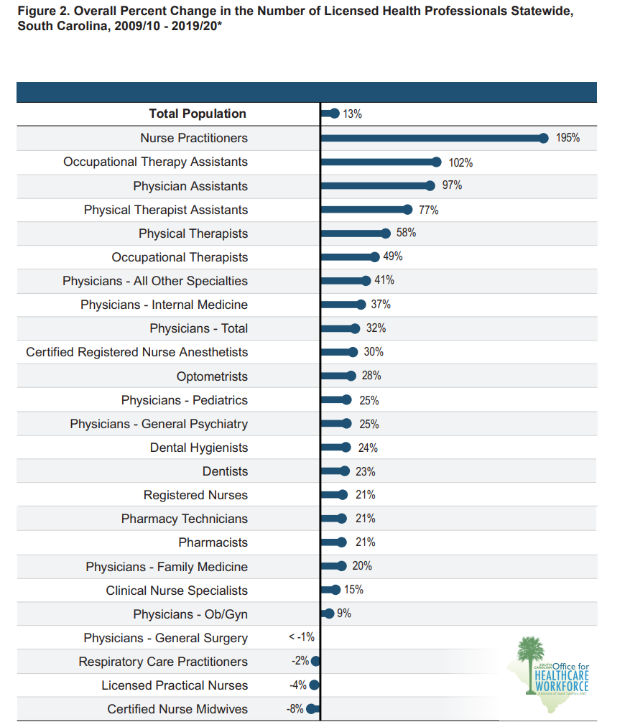
Tremendous Growth in Number of NPs and PAs and Growth of Primary Care Physicians Under Current Law
Notes:
There are still more physicians. 13k physicians to 7k NPs

Slide 10
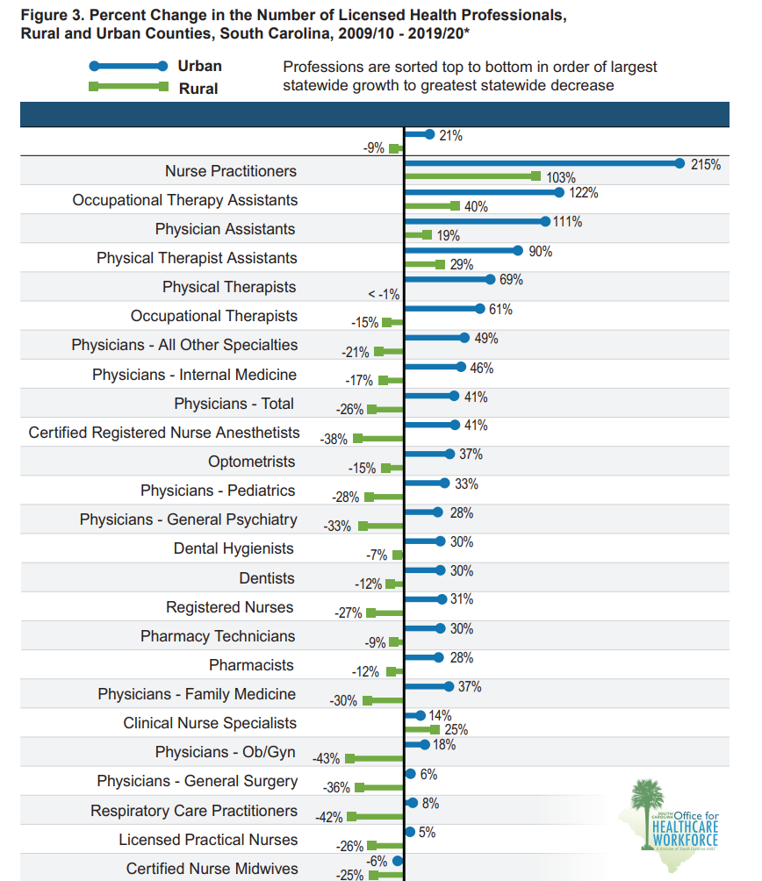
Number of NPs and PAs in Rural Counties Increased Under Current Law
Notes:
Is part of this because of hiring practices from larger hospital systems.

Slide 11
SC’s 28 Rural Counties | Total Physicians – 2021 | Total NPs (primary and specialty care) – 2022
Abbeville | 18 | 9
Allendale | 10 | 9
Bamberg | 7 | 7
Barnwell | 8 | 10
Calhoun | 1 | 2
Cherokee | 34 | 26
Chester | 23 | 9
Chesterfield | 28 | 23
Clarendon | 28 | 21
Colleton | 43 | 24
Darlington | 69 | 45
Dillion | 30 | 21
Edgefield | 21 | 9
Fairfield | 10 | 11
Hampton | 17 | 15
Jasper | 22 | 16
Kershaw | 89 | 47
Laurens | 61 | 27
Lee | 4 | 6
McCormick | 6 | 3
Marion | 21 | 22
Marlboro | 17 | 18
Newberry | 33 | 18
Oconee | 155 | 71
Orangeburg | 126 | 65
Saluda | 7 | 6
Union | 8 | 14
Williamsburg | 13 | 9
Even with the Tremendous Growth in NPs Over the Last Decade, SC Physicians are Still Equal in Number or Outnumber NPs in 21 of the 28 Rural Counties
Notes:
This does not even take into account that there is not a mileage restriction now!

Slide 12
The previous legislation did a great job of eliminating barriers to practice in rural areas
28 Rural South Carolina Counites | # of Primary Care Physicians (does not include other specialties) | # of NPs | # of PAs | # of APPs Existing Primary Care Physicians Could Supervise (total physicians X 6)
Abbeville | 13 | 9 | 3 | 78
Allendale | 6 | 9 | 0 | 54
Bamberg | 5 | 7 | 3 | 30
Barnwell | 8 | 10 | 1 | 48
Calhoun | 1 | 2 | 0 | 6
Cherokee | 29 | 26 | 5 | 174
Chester | 10 | 9 | 2 | 60
Chesterfield | 15 | 23 | 1 | 90
Clarendon | 16 | 21 | 7 | 96
Colleton | 27 | 24 | 12 | 162
Darlington | 41 | 45 | 8 | 246
Dillon | 21 | 21 | 3 | 126
Edgefield | 14 | 9 | 4 | 84
Fairfield | 6 | 11 | 1 | 36
Hampton | 7 | 15 | 7 | 42
Jasper | 6 | 16 | 6 | 36
Kershaw | 42 | 47 | 9 | 252
Laurens | 34 | 27 | 5 | 204
Lee | 3 | 6 | 0 | 18
McCormick | 4 | 3 | 0 | 24
Marion | 12 | 22 | 3 | 72
Marlboro | 12 | 18 | 1 | 72
Newberry | 22 | 18 | 6 | 132
Oconee | 72 | 71 | 15 | 432
Orangeburg | 53 | 65 | 17 | 318
Saluda | 6 | 6 | 2 | 36
Union | 7 | 14 | 2 | 42
Williamsburg | 7 | 9 | 2 | 42
In 2022, there were 13,531 total physicians in South Carolina with 5,195 practicing primary care
In 2022, there were a total combined number of 7,199 combined number of NPs (including NPs, CNMs, and CNSs) and PAs in SC
Primary care physicians could practice in a clinical environment with 31,170 NPs and PAs
  81,000 with all physicians
There are no counties in SC without a primary care physician
Every rural county there is room to grow
*NPs and PAs could also be supervised by a physician outside the county

Slide 13
3. NPs and Physicians practice in the same areas of the state

Slide 14
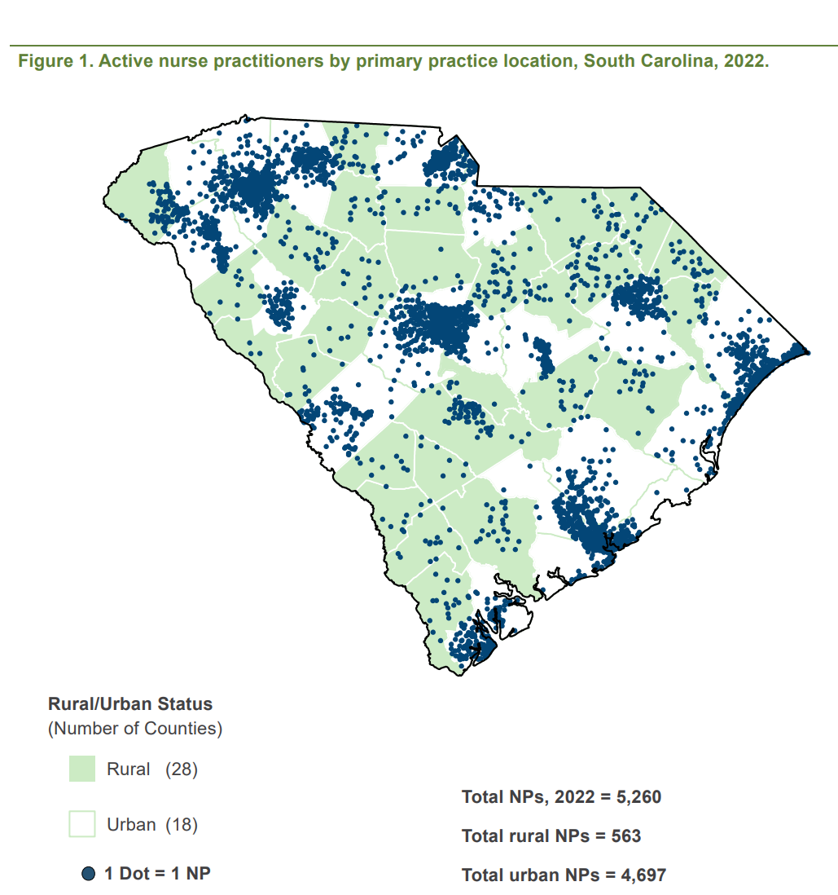
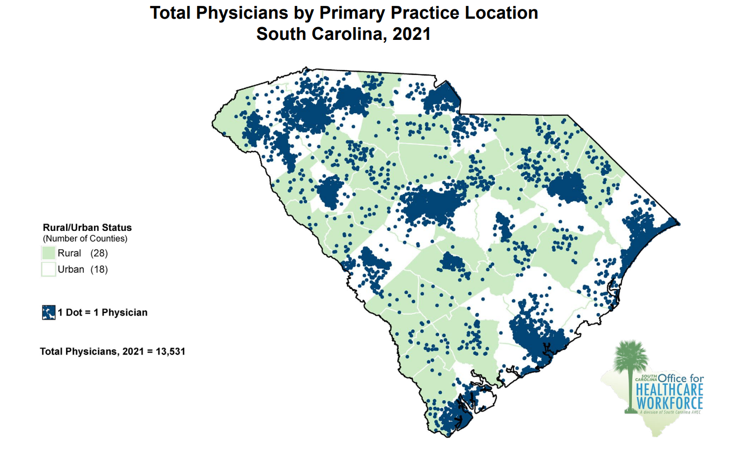
Percent of NPs (total) and Physicians (Total) Practicing in Rural SC Counties
10.7% of NPs Practice in Rural SC Counties
6.7% of Total Physicians practice in rural SC counties
Rural Physicians, (excluding federal physicians) 909
Notes:
These are only listing FNP by degree, not by what they do!

Slide 15
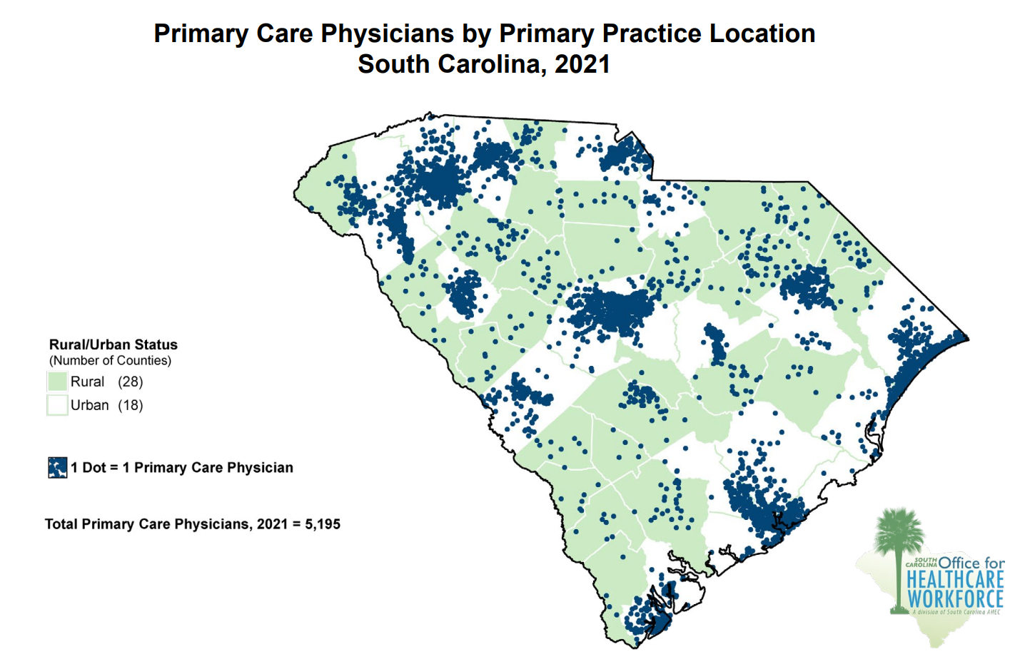
Percent of NPs (total) and Primary Care Physicians Practicing in Rural SC Counties
10.7% of NPs Practice in Rural SC Counties
9.6% of Primary Care Physicians Practice in rural SC counties
Rural Primary Care Physicians 499
Notes:
And remember based on the most recent study and national trend, only about 1/3 of the NPs are practicing primary care.

Slide 16
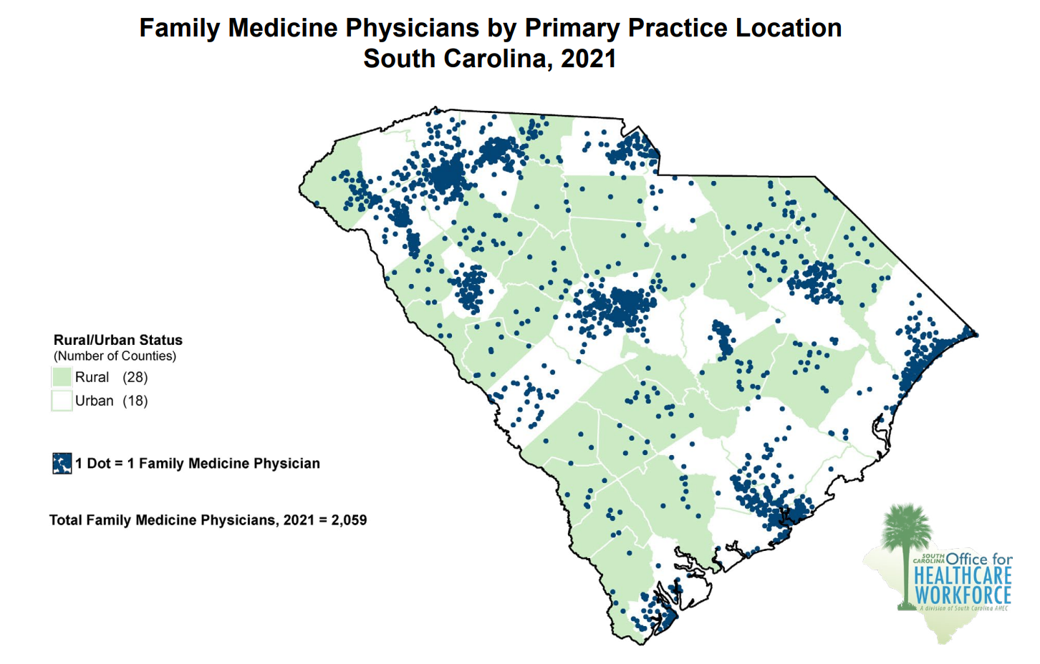
Percent of NPs (total) and Family Medicine Physicians Practicing in Rural SC Counties
10.7% of NPs practice in rural SC counties
13.4% of Family Medicine Physicians Practice in Rural SC Counties
Rural Family Practice 276
Notes:
And remember based on the most recent study and national trend, only about 1/3 of the NPs are practicing primary care.

Slide 17
4. Granting independent practice in other states has not solved the issue

Slide 18
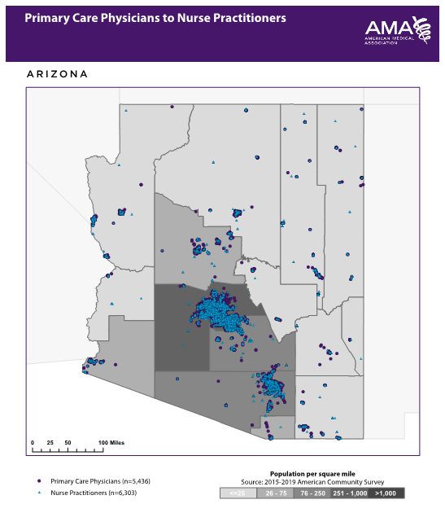
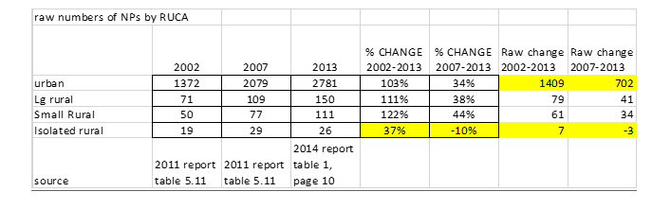
Physicians and NPs Practice in the Same Areas of the State, Regardless of Scope of Practice Laws
(Arizona passed independent practice in 2002)
https://crh.arizona.edu/sites/default/files/2022-04/AZ_Workforce_Trend_Analysis_2007-10_0.pdf
https://crh.arizona.edu/sites/default/files/2022-04/PA_NP_CNM_workforce_report.pdf

Slide 19
Physicians and NPs Practice in the Same Areas of the State, Regardless of Scope of Practice Laws (Oregon expanded practice in 1979 and independent in 1994)

Slide 20
Another Study Showing NPs Do Not Move to Rural Areas
The Graduate Nurse Education Demonstration Project
    Federally funded project through the Centers for Medicare and Medicaid Services
5 nursing schools
    Received a total of $176,377,493 with a stated goal of directing new Nurse Practitioners to rural and underserved areas
After 5 years…
  Only 9% of NPs went to rural areas
Exit interviews indicated that Nurse Practitioners chose practices in which they could get the schedule they wanted
https://www.cms.gov/priorities/innovation/files/reports/gne-final-eval-rpt.pdf
Notes:
Duke, Upenn, Memorial Hermann-Texas, Rush, HonorHealth (Scottsdale)

Slide 21
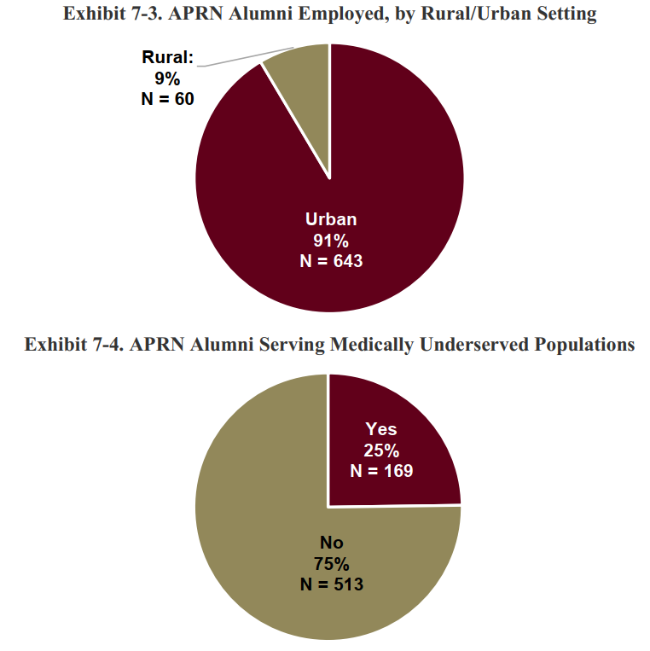
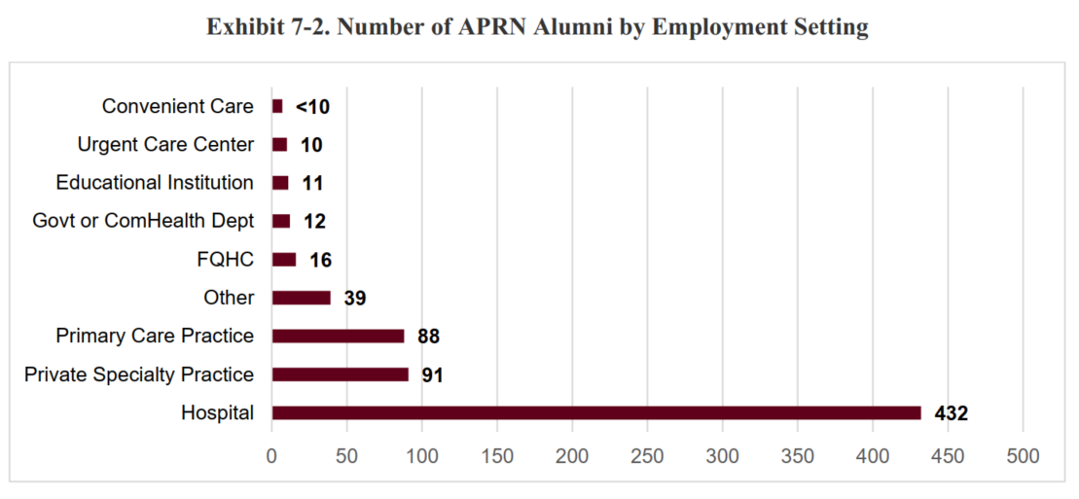

Slide 22
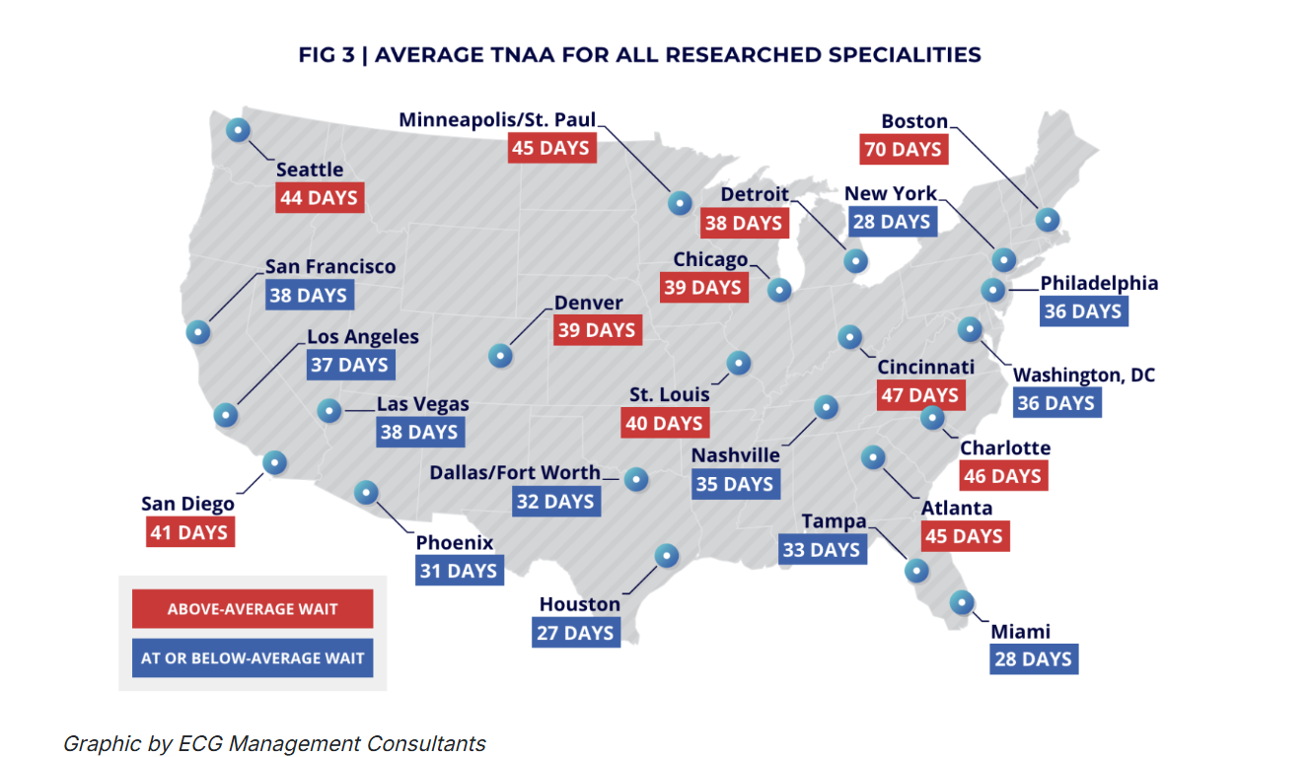
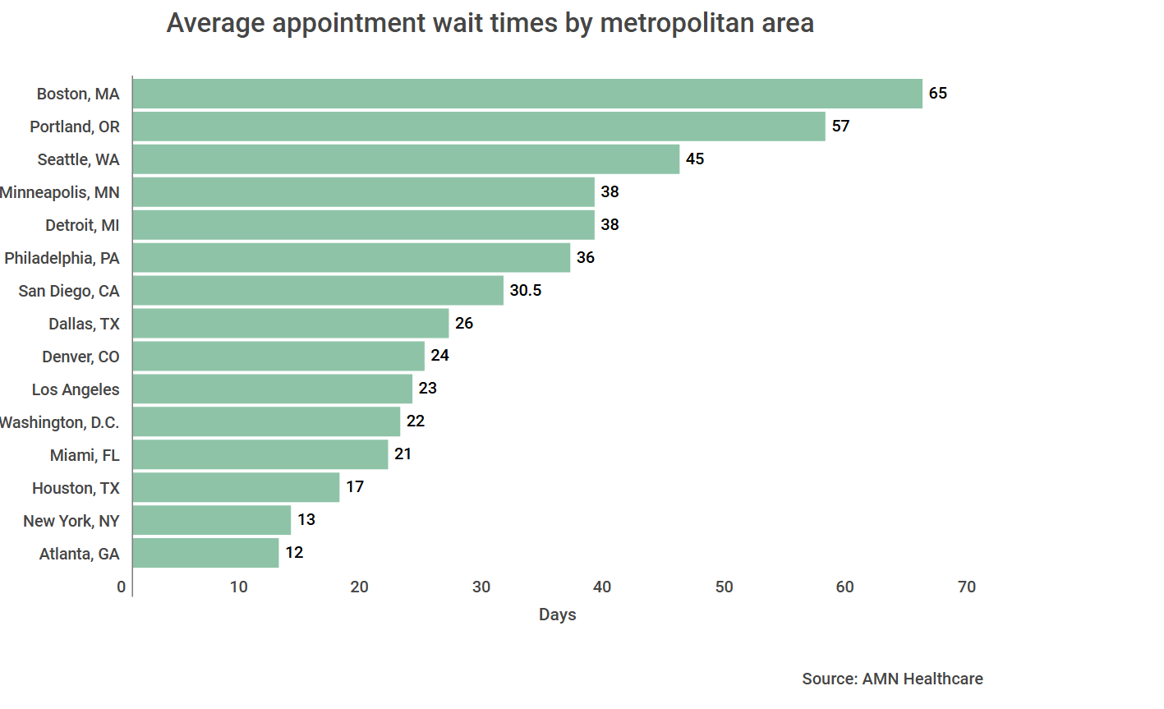















Independent Practice Does Not Reduce Wait Times
Notes:
Alaska, Arizona, Colorado, Connecticut, Delaware, Hawaii, Idaho, Iowa, Kansas, Maine, Maryland, Massachusetts, Minnesota, Montana, Nebraska, Nevada, New Hampshire, New Mexico, New York, North Dakota

Slide 23
5. Granting independent practice will not solve the issue in SC either

Slide 24
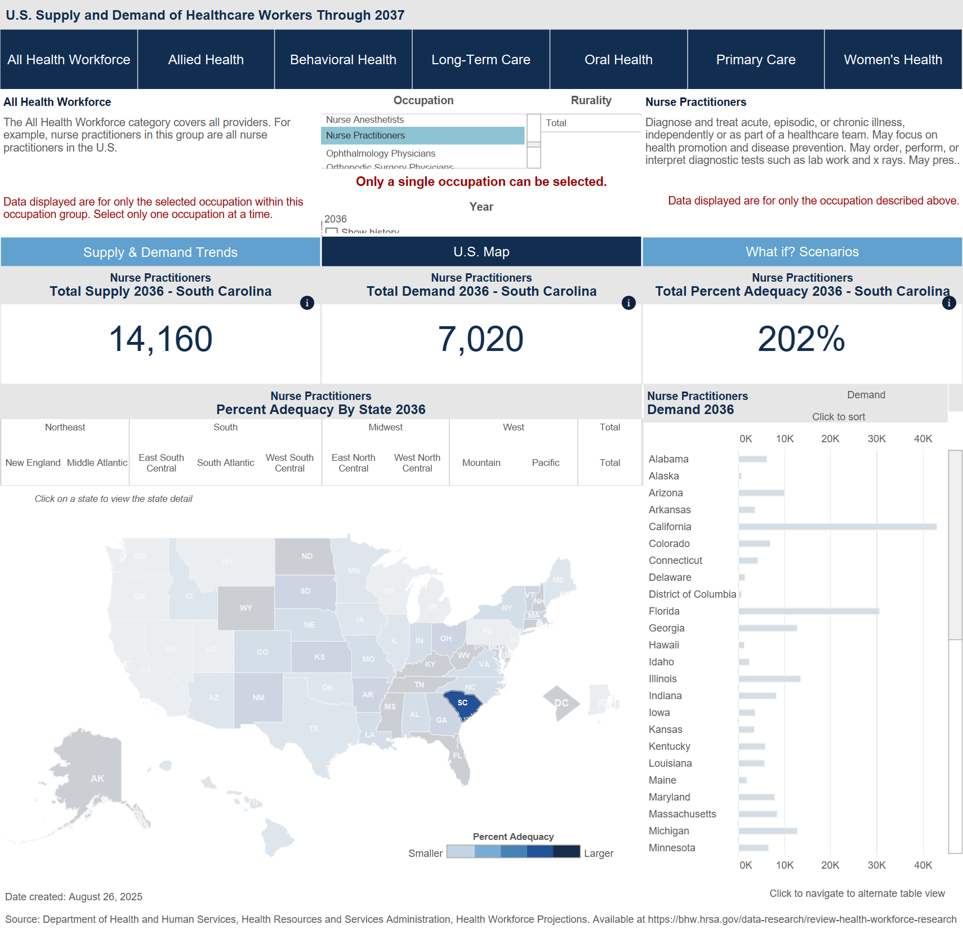
By 2036, Total Supply will Exceed Demand for NPs in South Carolina by over 200%
Notes:
If you continue with the current rate of growth, and keep the same growth projection, it may even be under-reporting.

Slide 25
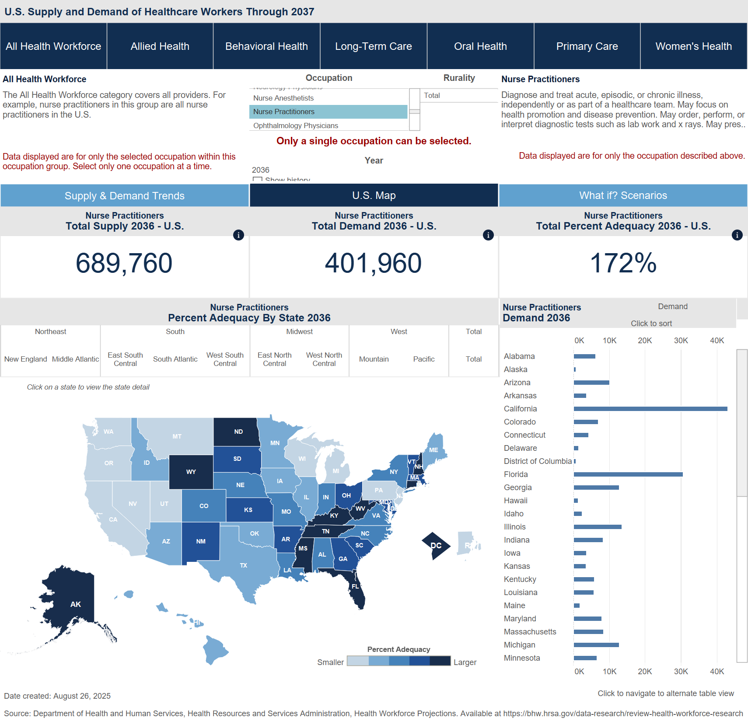
South Carolina Will Have One of the Larger Surpluses of NPs by 2036
Notes:
Alaska, Arizona, Colorado, Connecticut, Delaware, Hawaii, Idaho, Iowa, Kansas, Maine, Maryland, Massachusetts, Minnesota, Montana, Nebraska, Nevada, New Hampshire, New Mexico, New York, North Dakota

Slide 26
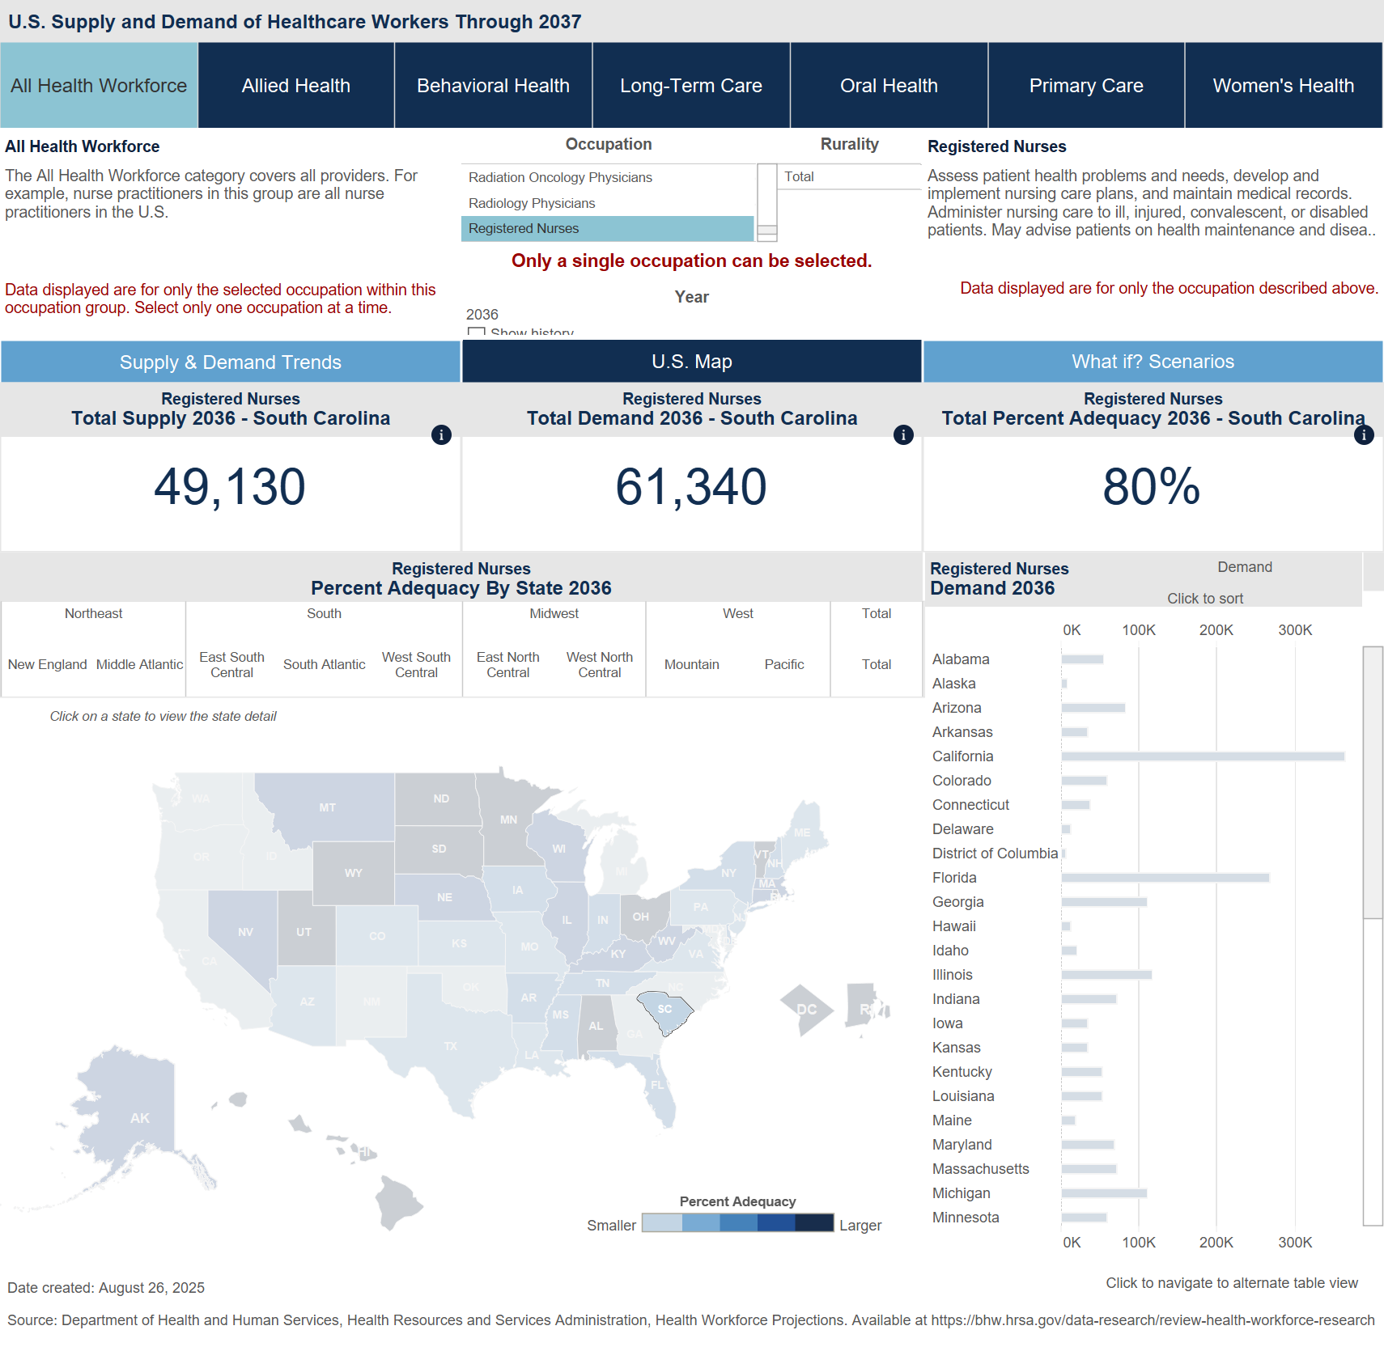
Meanwhile, SC is Projected to Have a Shortage of RNs in 2036

Slide 27
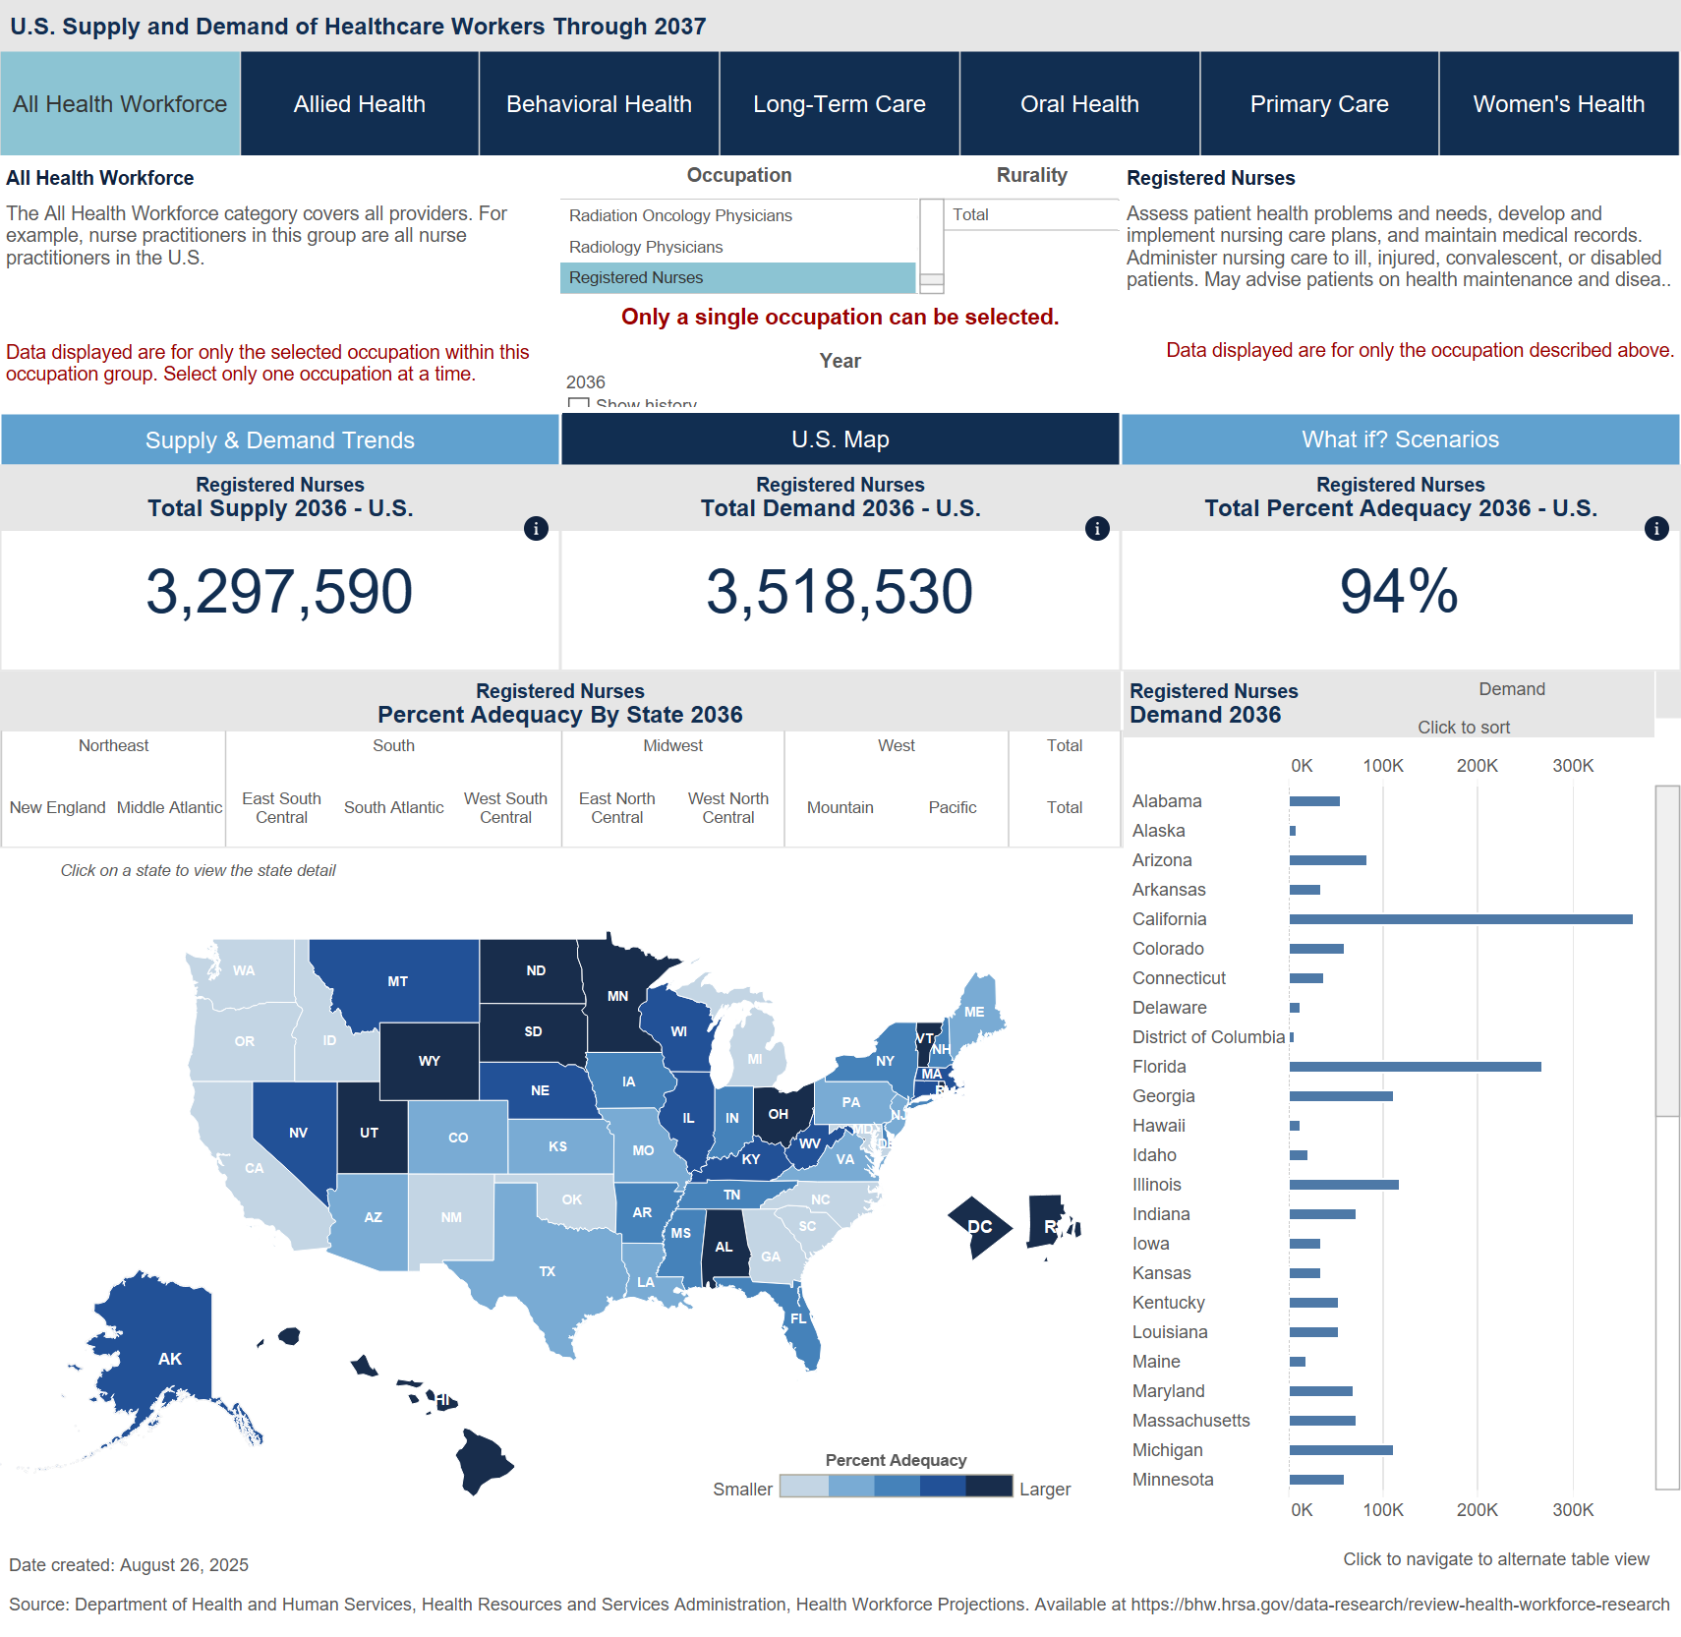
With South Carolina Having One of the Largest Shortages of RNs in the Country

Slide 28
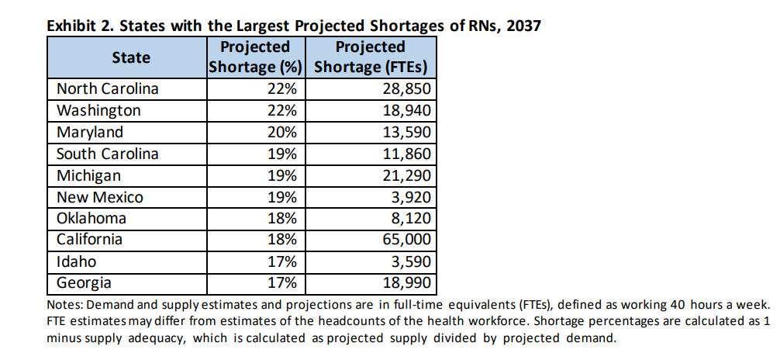
In Fact, by 2037, South Carolina is Projected to Have the 4th Largest Shortage of RNs in the Country

Slide 29
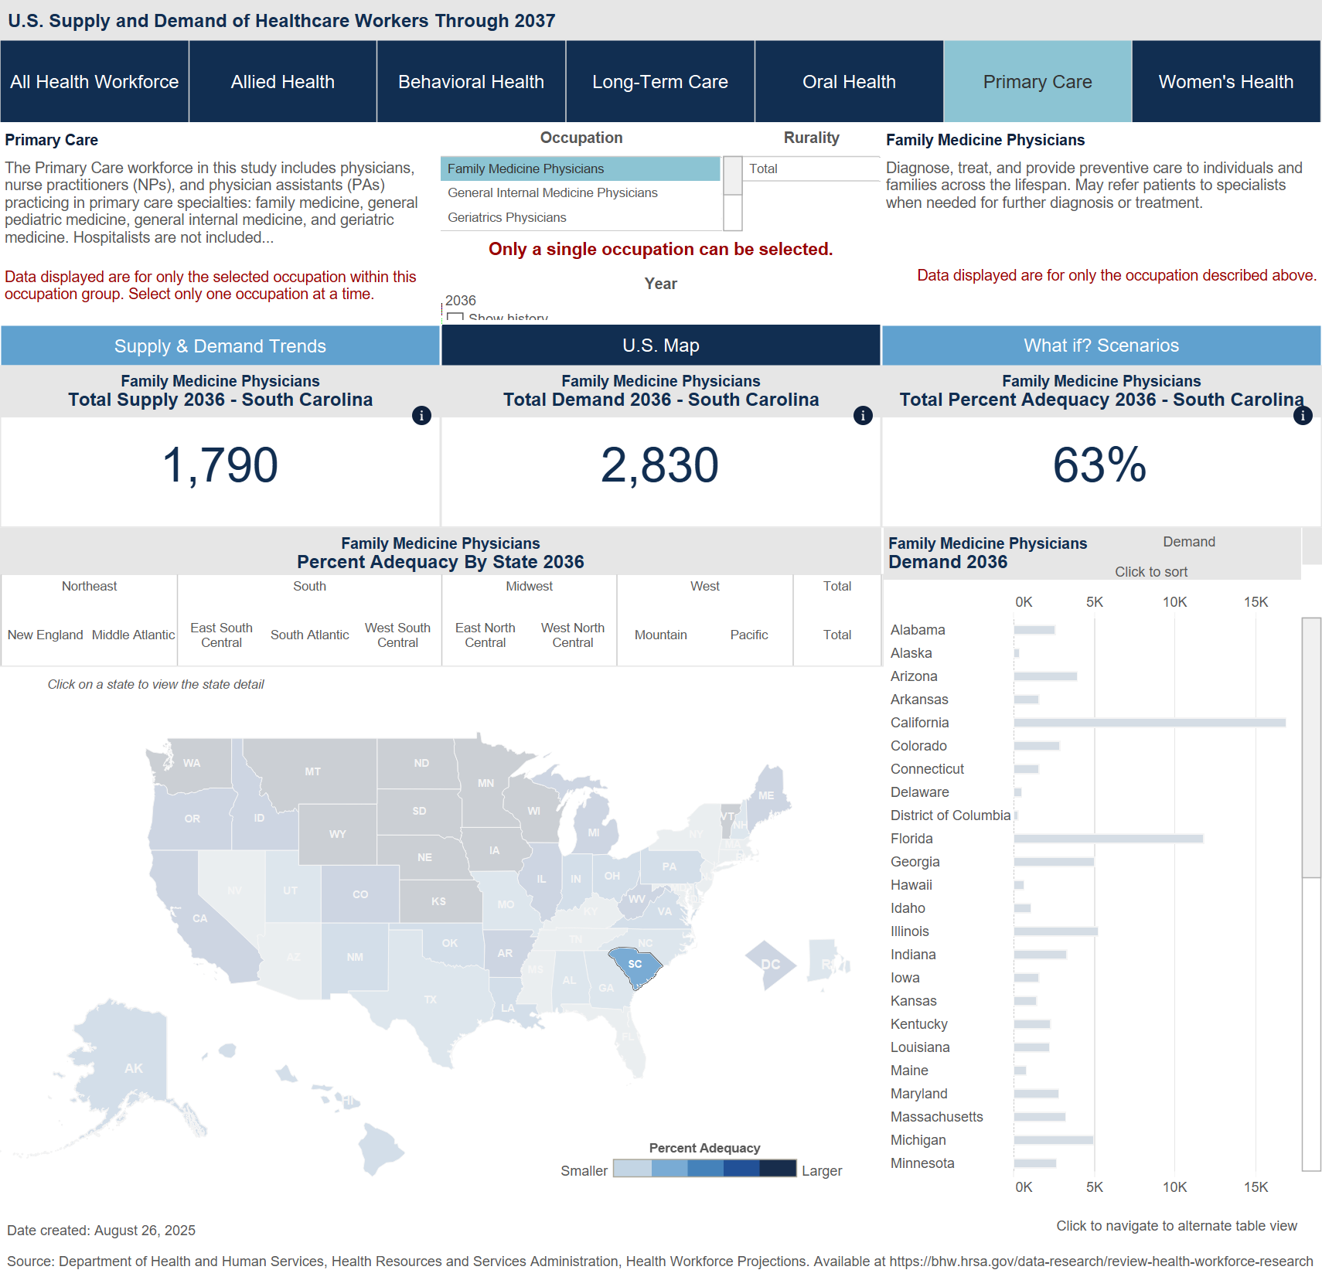
Also, There is a Projected Shortage of Family Physicians South Carolina in 2036

Slide 30
6. There are better solutions

Slide 31

Looking to the Future (and use of resources)
Instead of trying to replace Family Medicine doctors with Nurse Practitioners (not in the best interest of patients) we should try to do the following:
Encourage retaining Registered Nurses (instead of the progression to NP – which has a surplus!)
Produce more Family Medicine (and Primary Care) Physicians!

Slide 32
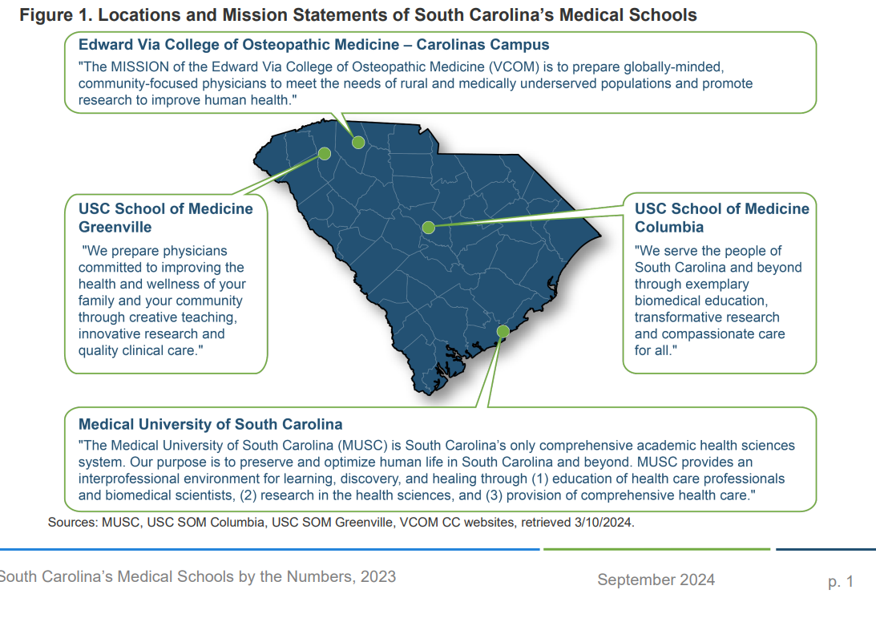
South Carolina’s Medical Schools

Slide 33
SC Medical Schools Accepting More In-State Students
Over the last decade, South Carolina medical schools have placed an emphasis on admitting South Carolina residents
 | MUSC | USC – Columbia | USC - Greenville | VCOM
Number of Applicants – 22-23 | 3,954 | 3,258 | 4,740 | 4,795
% In-State | 13.9% | 14.0% | 10.5% | 3.4%
% Out of State | 86.1% | 85.7% | 89.5% | 96.6%
Number of Matriculants – 22-23 | 171 | 100 | 105 | 163
% In-State | 83.0% | 74.0% | 58.1% | 23.3%
% Out of State | 17.0% | 26.0% | 41.9% | 76.7%
Number in Graduating Class – 21-22 | 153 | 97 | 101 | 160

Slide 34
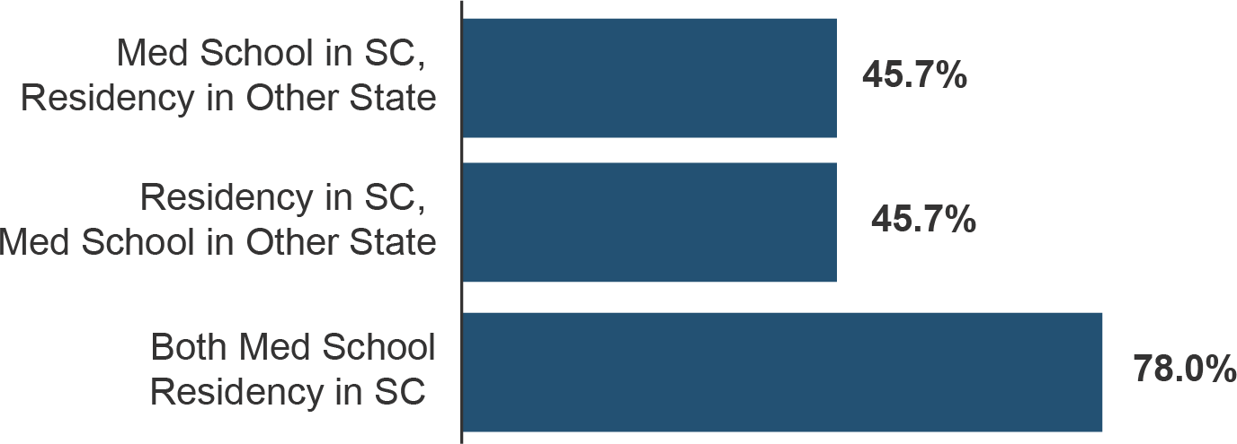
Retention of Active U.S. Physicians Who Trained in South Carolina as of December 2020

Slide 35
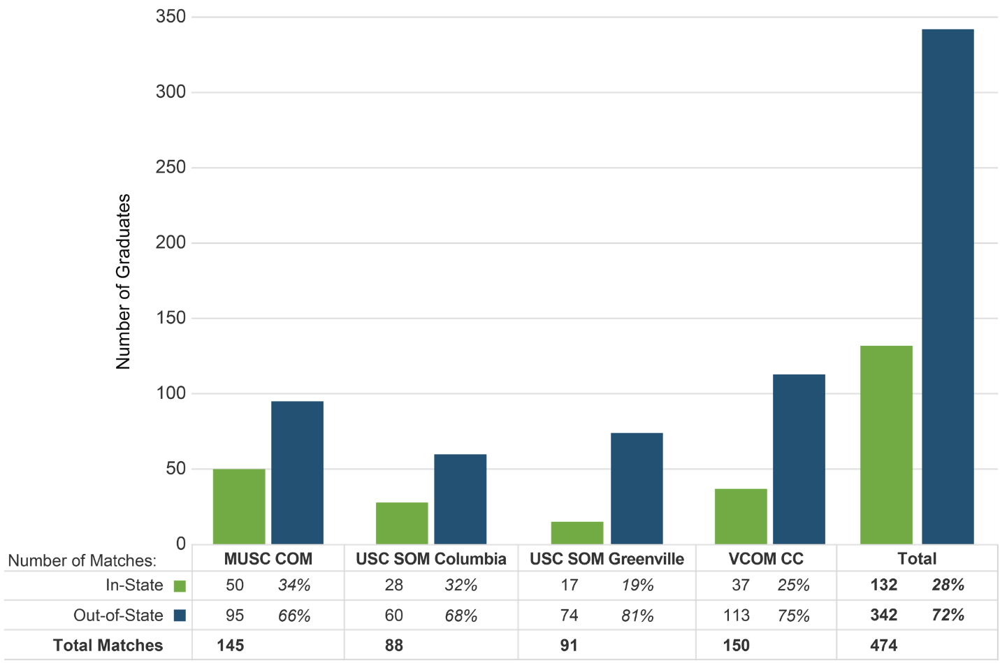
SC is Losing Almost Three-Quarters of Its Medical Students to Out of State Residencies
However, South Carolina loses almost three-fourths of its medical students to out-of-state residencies.
In-State vs. Out-of-State Matches by South Carolina Medical School, 2024

Slide 36

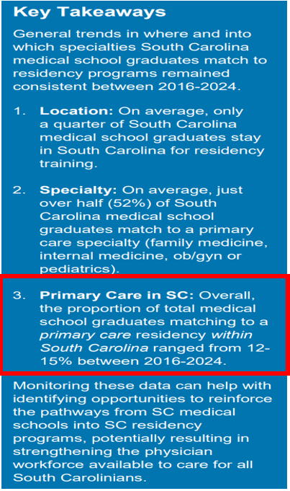
Focus on more Family Medicine Physicians!
As Policy Makers, we should focus on what will help get care to the rural areas
Precisely what the SCDHHS is doing!
  $10 million additional GME funding allocated in 2025

Slide 37
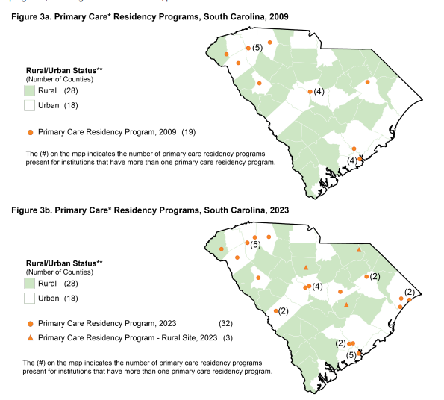
The Number of Primary Care and Rural Residency Programs has Grown in SC
Notes:
Increase in 16 sites. Primary Care Residencies in 2009 were 19 (this includes IM, FM, OB and Peds)
In 14 years we now we have 35 with 3 being focused on rural hospitals and patients.

Slide 38
SOUTH CAROLINA IS ADDRESSING THE ISSUE (THESE EFFORTS WILL PAY OFF)
Data shows the best way to address the physician shortage in our state is to educate and train in South Carolina
Retain more SC trained medical students for Residency in SC
Continue to grow the rural residency slots
Create more middle school, high school and college pipeline programs
DHHS Grant will help but will take time (physician education is more in depth and takes longer!)

Slide 39
SOUTH CAROLINA IS ADDRESSING THE ISSUE (THESE EFFORTS WILL PAY OFF)
Rural Pipeline programs for Registered Nurses
Incentivizing Registered Nurses to remain at the RN level
Loan forgiveness and more grant funding to move to rural areas
Can help with loan repayments for RNs staying in the field
Remember, the shortage of RNs (and surplus of NPs)

Slide 40
Thank you for listening and considering!
I hope we can work together to help the patients in rural areas
  Focus on ways that will really help
We appreciate the state legislature not making changes because “other states are doing it” but to take a detailed look at what is best for our patients
With the resources we have, please focus on increasing the primary care physician and RN workforce (which is in need) and not focusing on a field that is in a surplus

Slide 41
Recap…there are better solutions!
Data Show that only a fraction of NPs provide primary care
If they were going to help rural primary care, NPs could have done so under existing law
NPs and Physicians practice in the same areas of the state
Granting independent practice in other states has not solved the issue
Granting independent practice will not solve the issue in SC Either
There are better solutions

Slide 46
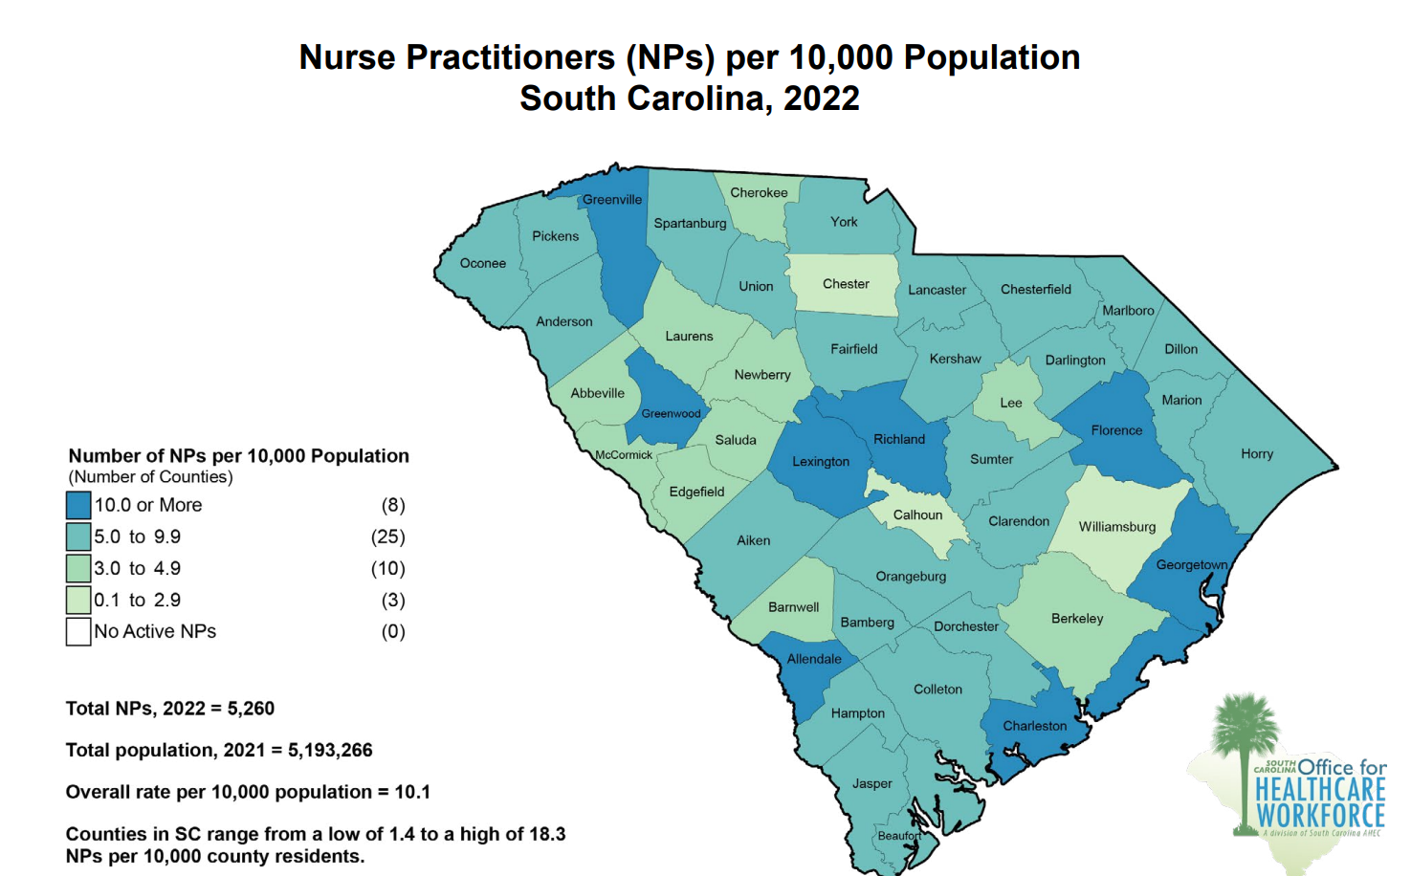
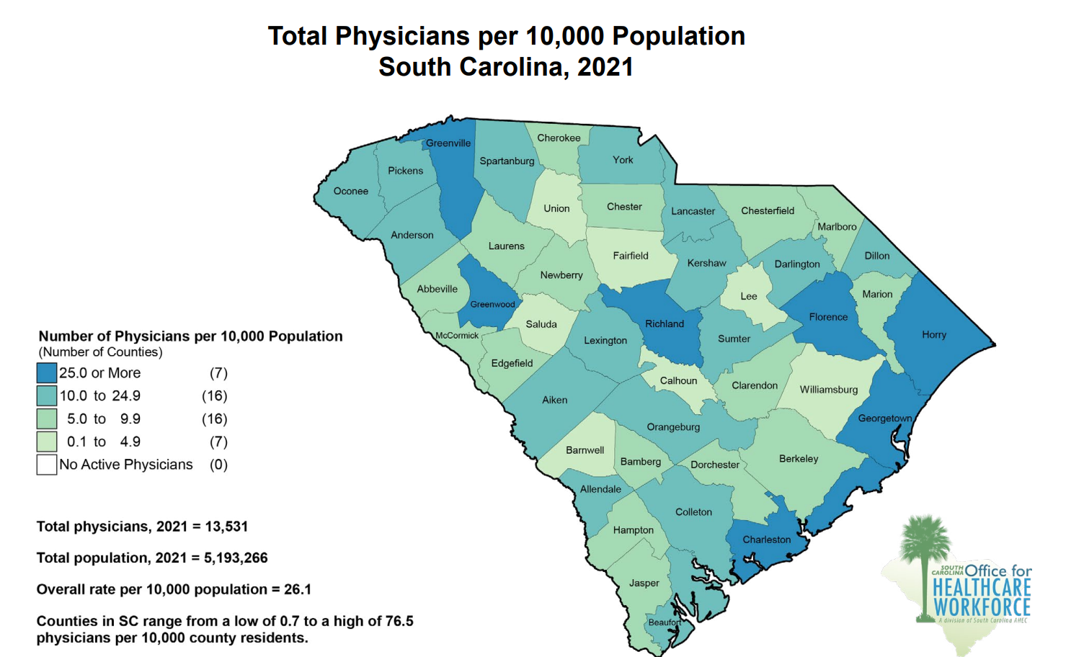


Number of NPs (Total) and Physicians (Total) per 10,000 population in SC
26.1 Total Physicians per 10,000 population
10.1 NPs (Total) per 10,000 population

Slide 47
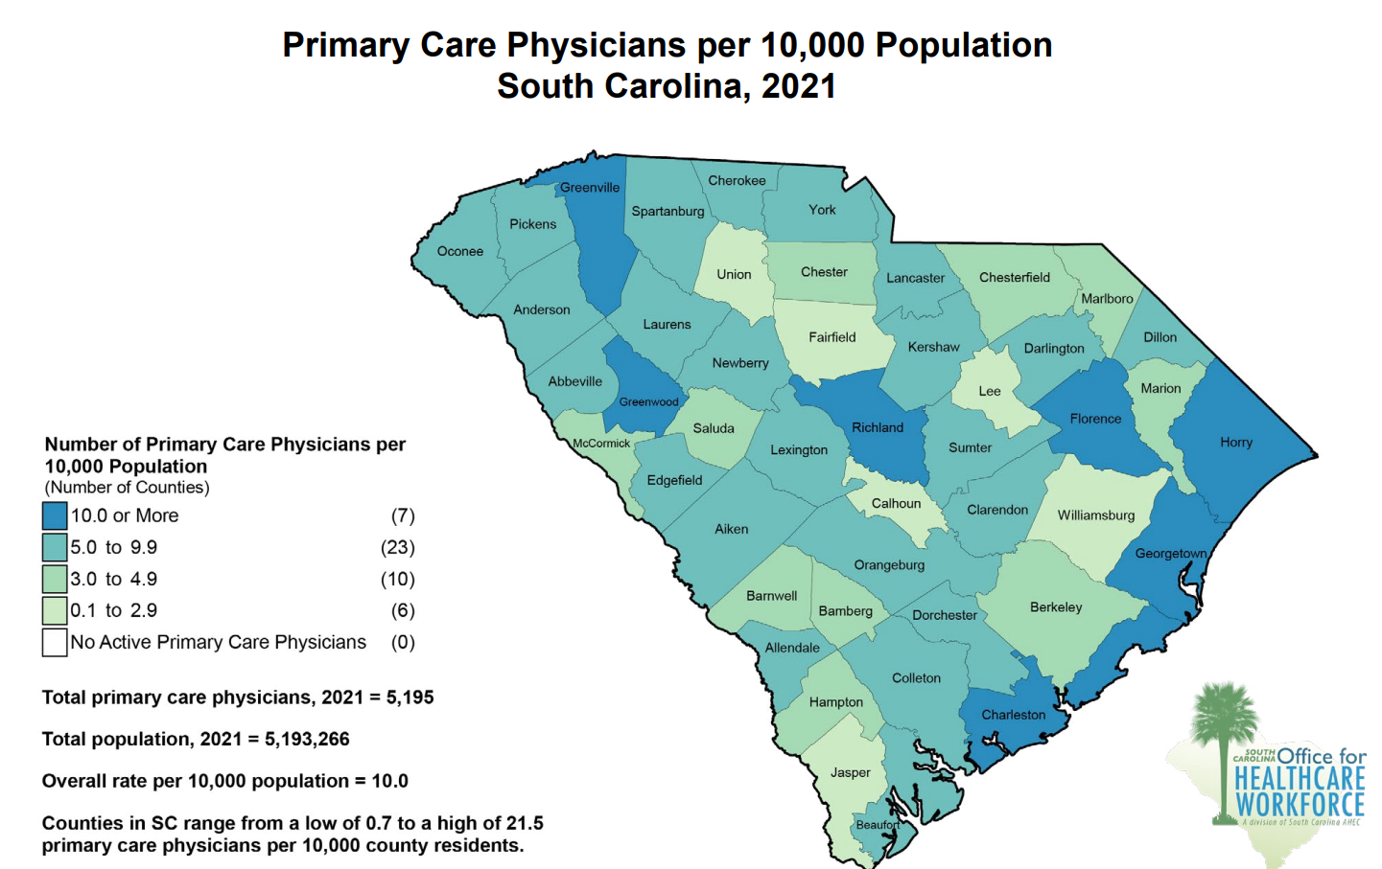


Number of NPs (Total) and Primary Care Physicians per 10,000 population in SC
10.1 NPs (Total) per 10,000 population
*Many of these NPs don’t practice primary care
10.0 Primary Care Physicians per 10,000 population
*There are no SC counties without a primary care physician

Slide 48
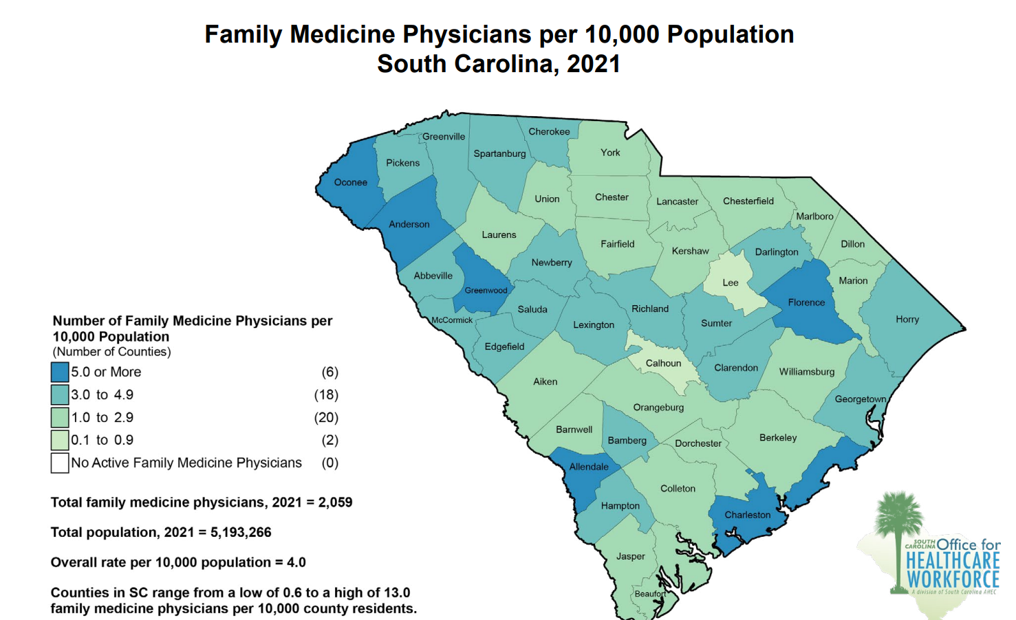


Number of NPs (Total) and Family Medicine Physicians per 10,000 population in SC
4.0 Physicians (Family Medicine) per 10,000 population
*There are no SC counites without a family medicine physician
10.1 NPs (Total) per 10,000 population
*Many of these NPs don’t practice primary care or family medicine

Slide 50
Standard Primary Care Year
Devised by Robert C. Bowman, MD
Wanted to devise a way to measure actual primary care, as measurements are often based on promises (more numbers=more rural primary care)
Formula allows for comparison across different specialties as well as for different graduation years
  The Standard Primary Care Year = Average Career Years X % remaining in PC for a career X % active for a career X % volume
Bowman RC. Measuring primary care: the standard primary care year. Rural and Remote Health 8: 1009. (Online) 2008

Slide 51
Who Gives the Most Primary Care
Calculation took into account 4 major factors:
  Factor 1: Primary care retention after specialization (percentage)
      How many specialize after initial primary care training
  Factor 2: Duration of career in primary care (in years)
      What percentage work towards the 35-year standard for this calculation
  Factor 3: Activity level compared with all graduates (as a percentage )
      What percentage of a 40-hour work week does the provider see patients
  Factor 4: Volume of primary care delivery compared with family physicians (as a percentage)
      Volume of patients seen in a day compared to family physicians

Slide 52
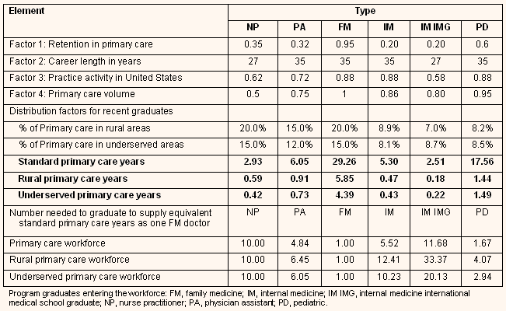
According to These Data
To replace the 29.3 standard primary care workforce years of one family physician it would take:
  10 nurse practitioner graduates, OR
  5 physician assistant graduates, OR
  5.5 internal medicine residency graduates, OR
  1.7 pediatrics residency graduates

Slide 53
Does the Data Show NPs Leaving SC?
“We have seen a trend of NPs leaving the states for FPA states” - Deborah Hopla
No data cited to support the claim
HOWEVER, data does exist.
SC Nurses association. APRN town hall meeting May 6,2025 . 35:45
NP numbers in South Carolina compared to states which passed independent practice laws
  US bureau of labor statistics data
  Note: numbers of NPs in almost every state are going up as a result of thef the flood of new NP graduates
Therefore, we should judge growth based on a comparison to states who have granted independent practice

Slide 54
Let us compare:
The change in numbers of NPs in states which passed
independent practice laws in 2015 (Minnesota, New York, Nebraska, Delaware) to the change in numbers of NPs in South Carolina
  -Follow the trend for 7 years
Hypothesis: States with newly passed independent practice laws should see a greater increase of NPs than South Carolina (which remained a collaboration state)
The data show PRECISELY the opposite: South Carolina (and other supervised states) have increased the number of NPs per 100,000 population MORE than states which adopt independent practice

Slide 55
Percent change in ratio of nurse practitioners to population (per 100,000 population)
129% Growth!

Slide 56
Data Show Many FNPs Are Choosing Specialty Care
According to a recent study published by KFF Health News, while 90% of NPs are certified to work in primary care, only about 1/3 choose that field of practice*
Like Doctors, More Nurse Practitioners Are Heading Into Specialty Care - KFF Health News
*Without any formal training in the selected specialty field of practice
Further evidence that the NP’s claim that 70% of them are practicing primary care in SC is false
Notes:
KFF is the former Kaiser Family Foundation

Slide 57
- In 2022, there were 13,531 total physicians in South Carolina with 5,195 practicing primary care meaning primary care physicians could practice in a clinical environment with 31,170 NPs and PAs (with only primary care doctors-81,000 with all physicians) at any given time and enter into many more agreements
-In 2022, there were a total number of 7,199 combined number of NPs (including NPs, CNMs, and CNSs) and PAs in SC
- There are no counties in SC without a primary care physician and in every rural county there is room to grow
*NPs and PAs could also be supervised by a physician outside the county
The previous legislation did a great job of eliminating barriers to practice in rural areas
28 Rural South Carolina Counites | # of Primary Care Physicians (does not include other specialties) | # of NPs | # of PAs | # of APPs Existing Primary Care Physicians Could Supervise (total physicians X 6)
Abbeville | 13 | 9 | 3 | 78
Allendale | 6 | 9 | 0 | 54
Bamberg | 5 | 7 | 3 | 30
Barnwell | 8 | 10 | 1 | 48
Calhoun | 1 | 2 | 0 | 6
Cherokee | 29 | 26 | 5 | 174
Chester | 10 | 9 | 2 | 60
Chesterfield | 15 | 23 | 1 | 90
Clarendon | 16 | 21 | 7 | 96
Colleton | 27 | 24 | 12 | 162
Darlington | 41 | 45 | 8 | 246
Dillon | 21 | 21 | 3 | 126
Edgefield | 14 | 9 | 4 | 84
Fairfield | 6 | 11 | 1 | 36
Hampton | 7 | 15 | 7 | 42
Jasper | 6 | 16 | 6 | 36
Kershaw | 42 | 47 | 9 | 252
Laurens | 34 | 27 | 5 | 204
Lee | 3 | 6 | 0 | 18
McCormick | 4 | 3 | 0 | 24
Marion | 12 | 22 | 3 | 72
Marlboro | 12 | 18 | 1 | 72
Newberry | 22 | 18 | 6 | 132
Oconee | 72 | 71 | 15 | 432
Orangeburg | 53 | 65 | 17 | 318
Saluda | 6 | 6 | 2 | 36
Union | 7 | 14 | 2 | 42
Williamsburg | 7 | 9 | 2 | 42

